Slide 1
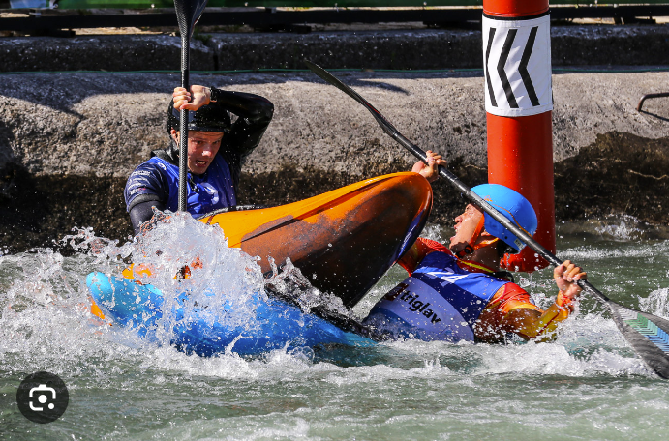
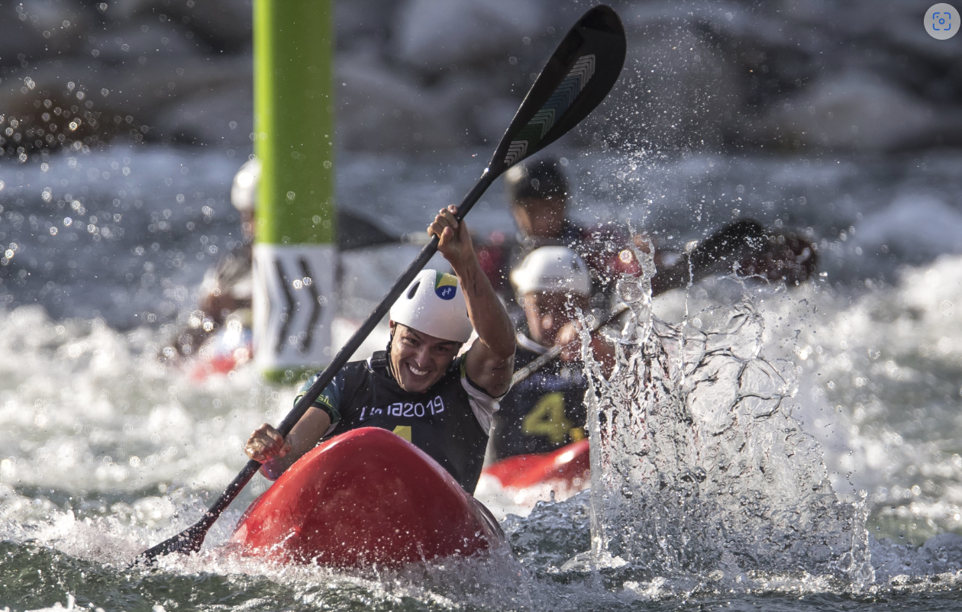
ITO Kayak Cross Briefing
2023 World Cup 5, Vaires sur Marne, FRA

Slide 2
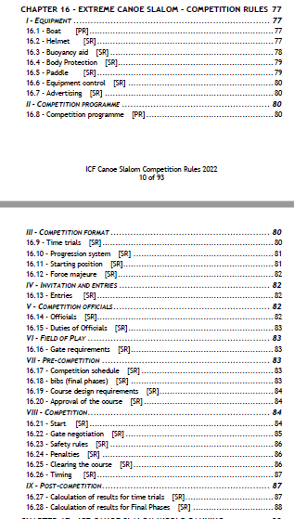
Rules Evolution
16. Kayak Cross rules
Sport rules modification possible every 2 years
Rules now fixed for 2023 and 2024

Slide 3
References
Canoe slalom is now a discipline with 2 events:
Canoe and Kayak slalom
Kayak Cross (Extreme kayak / Extreme slalom / Boater Cross / Paddles Up / …)

Slide 4
Phases
Qualification phase (Time Trial)
A repechage may be included
Elimination Phase
Knock out rounds
Heats, Quaterfinal, Semifinal, Final

Slide 5
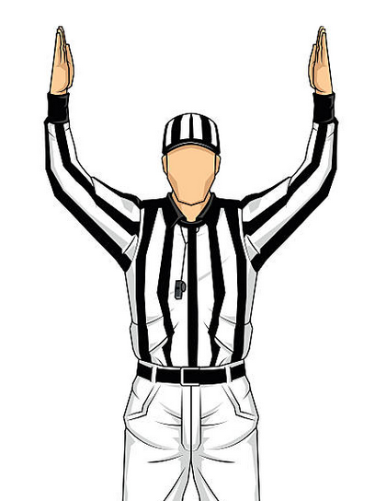
Role of the ITO’s
Canoe and Kayak Slalom
Kayak Cross

Slide 6
Boats
Requirements
List edited by the ICF for level 1, 2 & 3
Mass produced, accessible for every athlete/NF to buy in a shop
Fitted with a handle < 50cm from each end
Full footplate footrest
No modifications to the outside of the boat.

Slide 7
Helmets
Requirements
List published by ICF
Enforced in all phases
Recommendations
Mouth guards, full face helmets
Work in progress - homologated helmets with grill or face mask protection

Slide 8
Life Jacket
Requirements
Buoyancy above the waist
Must be on ICF Register, (now enforced)

Slide 9
Paddles
Requirements
The paddle edges min radius of 2.5mm for the whole edge
May be original or taped
Metal tipped paddle blades are not permitted.
Athletes are not permitted to start without a paddle.

Slide 10
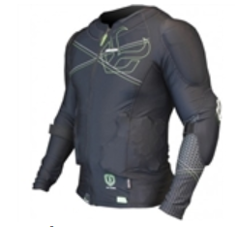
Body Protection
Requirements
Long sleeves at all competition phases
Recommendations
Pads on the arms and shoulder as in ski

Slide 11
Equipment Control
Pre or post competition
Pre competition equipment fail = DNS
Post competition equipment fail = DSQ
Usually, Qualification phase is post competition and Elimination phase is pre competition

Slide 12
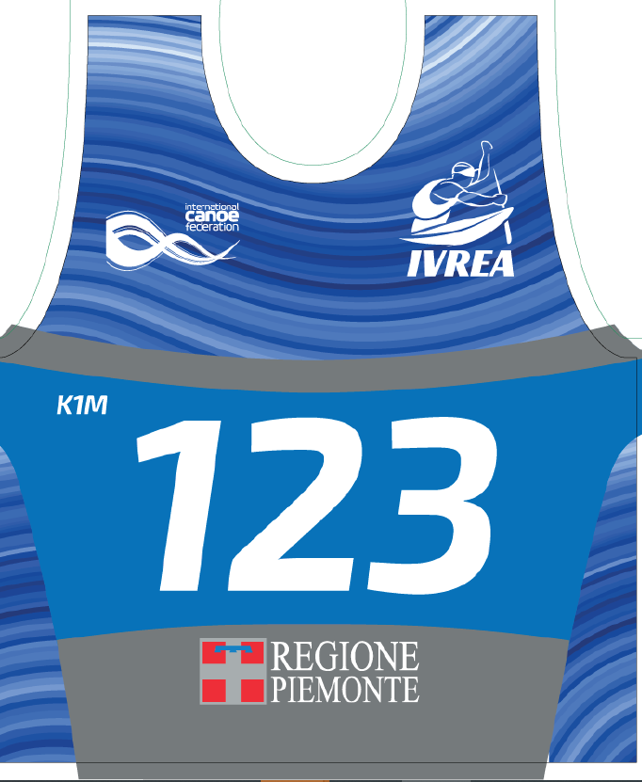
Bibs
Qualification phase (Time trial)
Numerical bibs, following the CSLX ICF World ranking.

Slide 13
Bibs
Elimination phase two types of bibs:
Numerical bibs based on qualification phase ranking
Coloured bibs based on rank in previous bracket
HEAT 1 (H1) |  | Bib n° | Color
1st | in time trial | 1 | R
16th | in time trial | 16 | G
17th | in time trial | 17 | B
32nd | in time trial | 32 | Y
Quaterfinal 1 (QF1) | Bib n° | Color
1st in H1 or H2 | lowest bib | R
1st in H1 or H2 | highest bib | G
2nd in H1 or H2 | lowest bib | B
2nd in H1 or H2 | highest bib | Y
HEAT 2 (H2) |  | Bib n° | Color
8th | in time trial | 8 | R
9th | in time trial | 9 | G
24th | in time trial | 24 | B
25th | in time trial | 25 | Y

Slide 14
Course Design
4 to 6 downstream gates, two pairs of upstream gates
Downstreams can be a pair of gates
Gates with 3 litres of water & touching the water
Course length up to 90 seconds

Slide 15
Course Design
Roll Zone and / or roll barrier (barrier in zone)
Normally no demonstration, but can be scheduled
Course published in advance
Practice and Qualification phase on published course

Slide 16
Start Order
Commands
"In position”
"Ready” Athlete remains still (no movement) between ready and movement of the ramp, or it’s a false start = FLT
“Go”
A start machine
Synchronized pneumatic or mechanical mechanism
Start order: After “Ready” the machine drops (no “Go”)
Notes:
before Ready = DNS
between ready and go = FLT

Slide 17
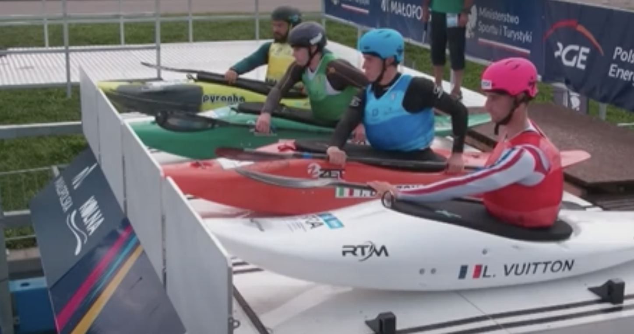
Start Position
The Athlete must start:
With both hands on the paddle
The front hand must be touching the boat/deck and at least halfway across the boat
Paddle may be on either side
The paddle must be
parallel to the deck of the platform
Notes:
before Ready = DNS
between ready and go = FLT

Slide 18
Roll Barrier Evolution
Old rule - Roll movement must be started before the barrier
New rule - Boat must be upside down at one point under the roll barrier
Notes:
This the plan, doesn’t apply here

Slide 19
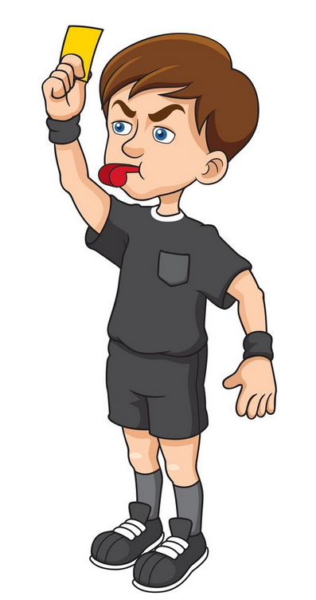
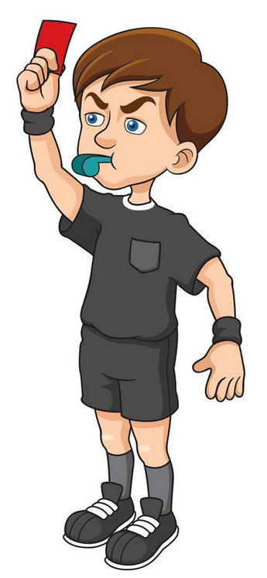
Fault vs Rank as Lower
Not following rules
FAULT (FLT)
Dangerous behaviour
RANK AS LOWER
(RAL)

Slide 20
Judging the Gates
Judge the gate and some of the space between the gates as agreed
One Judge per gate
Look for foul play – can reach across but not hold back
Look for intentional move of gate to disadvantage others
Broken paddle – drop back out of group, or just use hands
Notes:
The gate line is the line from the outside of the gate to the bank on the same side.
The following conditions must be satisfied for a gate to be considered correctly negotiated:
The whole head and both shoulders of the athlete must cross the gate line in accordance with the correct side of the gate and the course plan.
Part of the boat must cross the gate line at the same instant as the whole head crosses the line.
All gates must be negotiated in accordance with the direction established by the course map.
Athletes are permitted to touch the gates with their body or any part of their equipment.

Slide 21
Judging the Gate – Correct Negotiation
As in slalom - correct order, direction
Can touch/move gates with paddle, boats or body
Cannot take hands of the paddle and move the gate with the hand
Intentional displacement (to disadvantage another) with the arm when the hand is on or off the paddle will be penalised (see rule 16:22:4)
Notes:
The gate line is the line from the outside of the gate to the bank on the same side.
The following conditions must be satisfied for a gate to be considered correctly negotiated:
The whole head and both shoulders of the athlete must cross the gate line in accordance with the correct side of the gate and the course plan.
Part of the boat must cross the gate line at the same instant as the whole head crosses the line.
All gates must be negotiated in accordance with the direction established by the course map.
Athletes are permitted to touch the gates with their body or any part of their equipment.

Slide 22
Renegotiation Gates
Athletes can renegotiate gates if they incur a FLT (unless in wrong direction)
For a pair of gates if the FLT is for “wrong direction” the Athlete could remove the FLT by correctly negotiating the second gate in the pair
The roll barrier can be renegotiated by, where possible, paddling back up the side in the area not under the barrier
Notes:
The gate line is the line from the outside of the gate to the bank on the same side.
The following conditions must be satisfied for a gate to be considered correctly negotiated:
The whole head and both shoulders of the athlete must cross the gate line in accordance with the correct side of the gate and the course plan.
Part of the boat must cross the gate line at the same instant as the whole head crosses the line.
All gates must be negotiated in accordance with the direction established by the course map.
Athletes are permitted to touch the gates with their body or any part of their equipment.

Slide 23
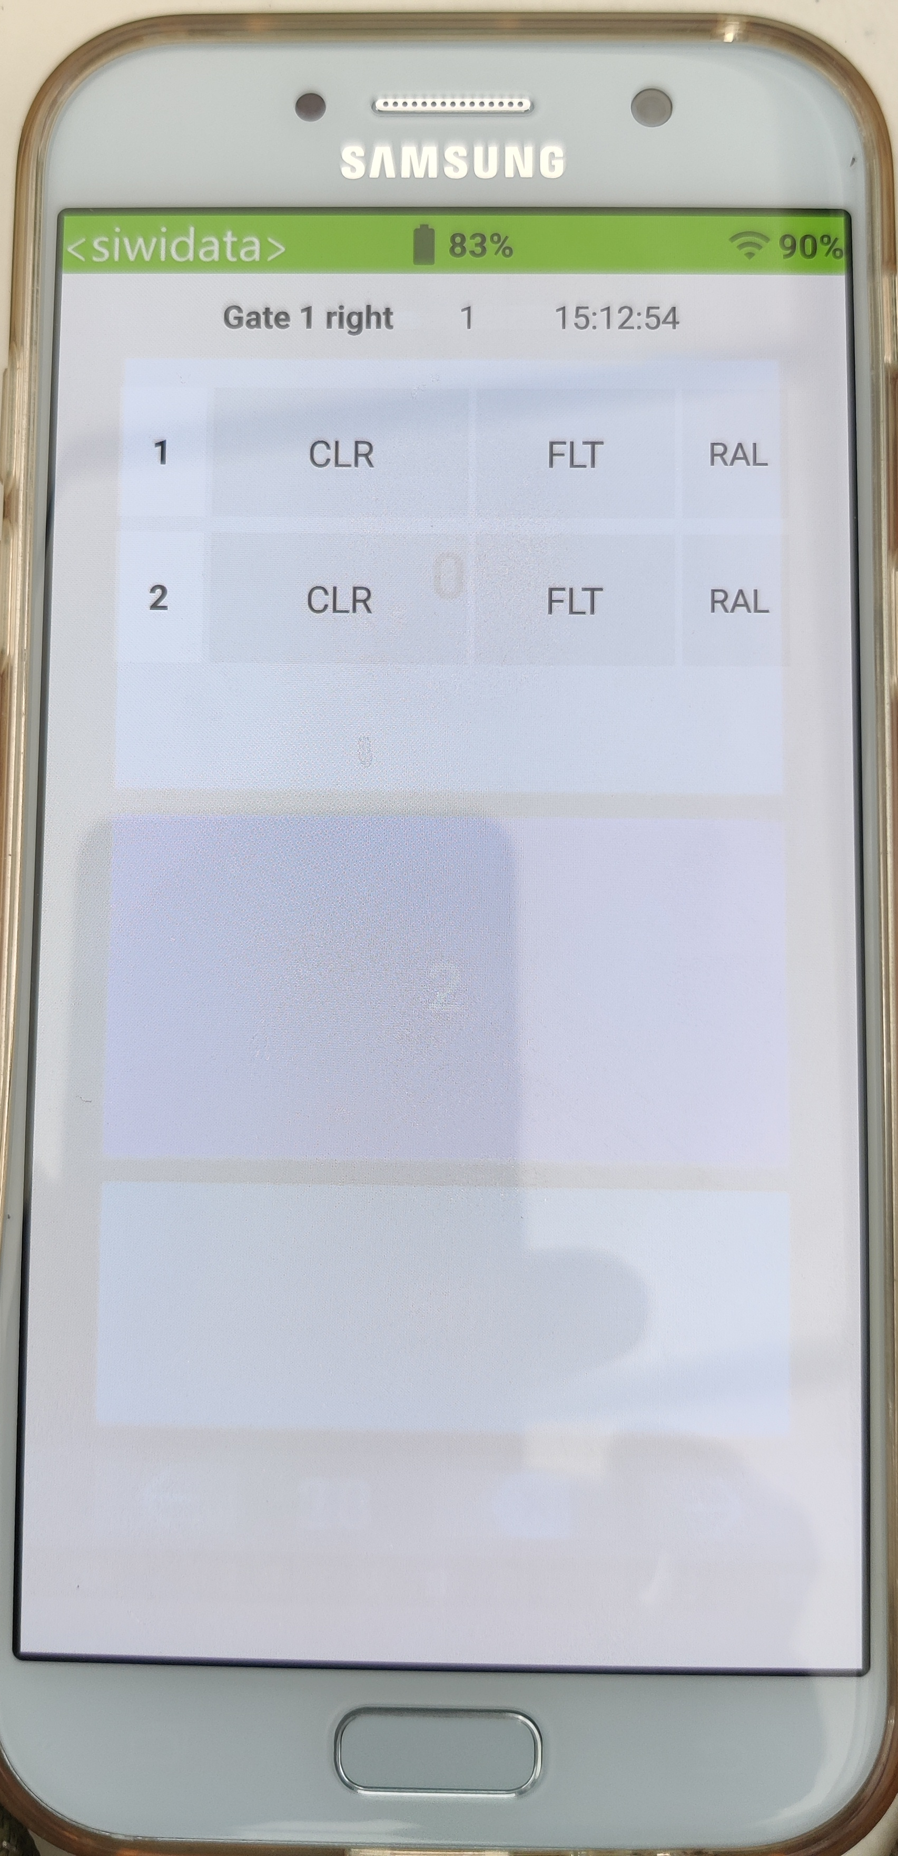
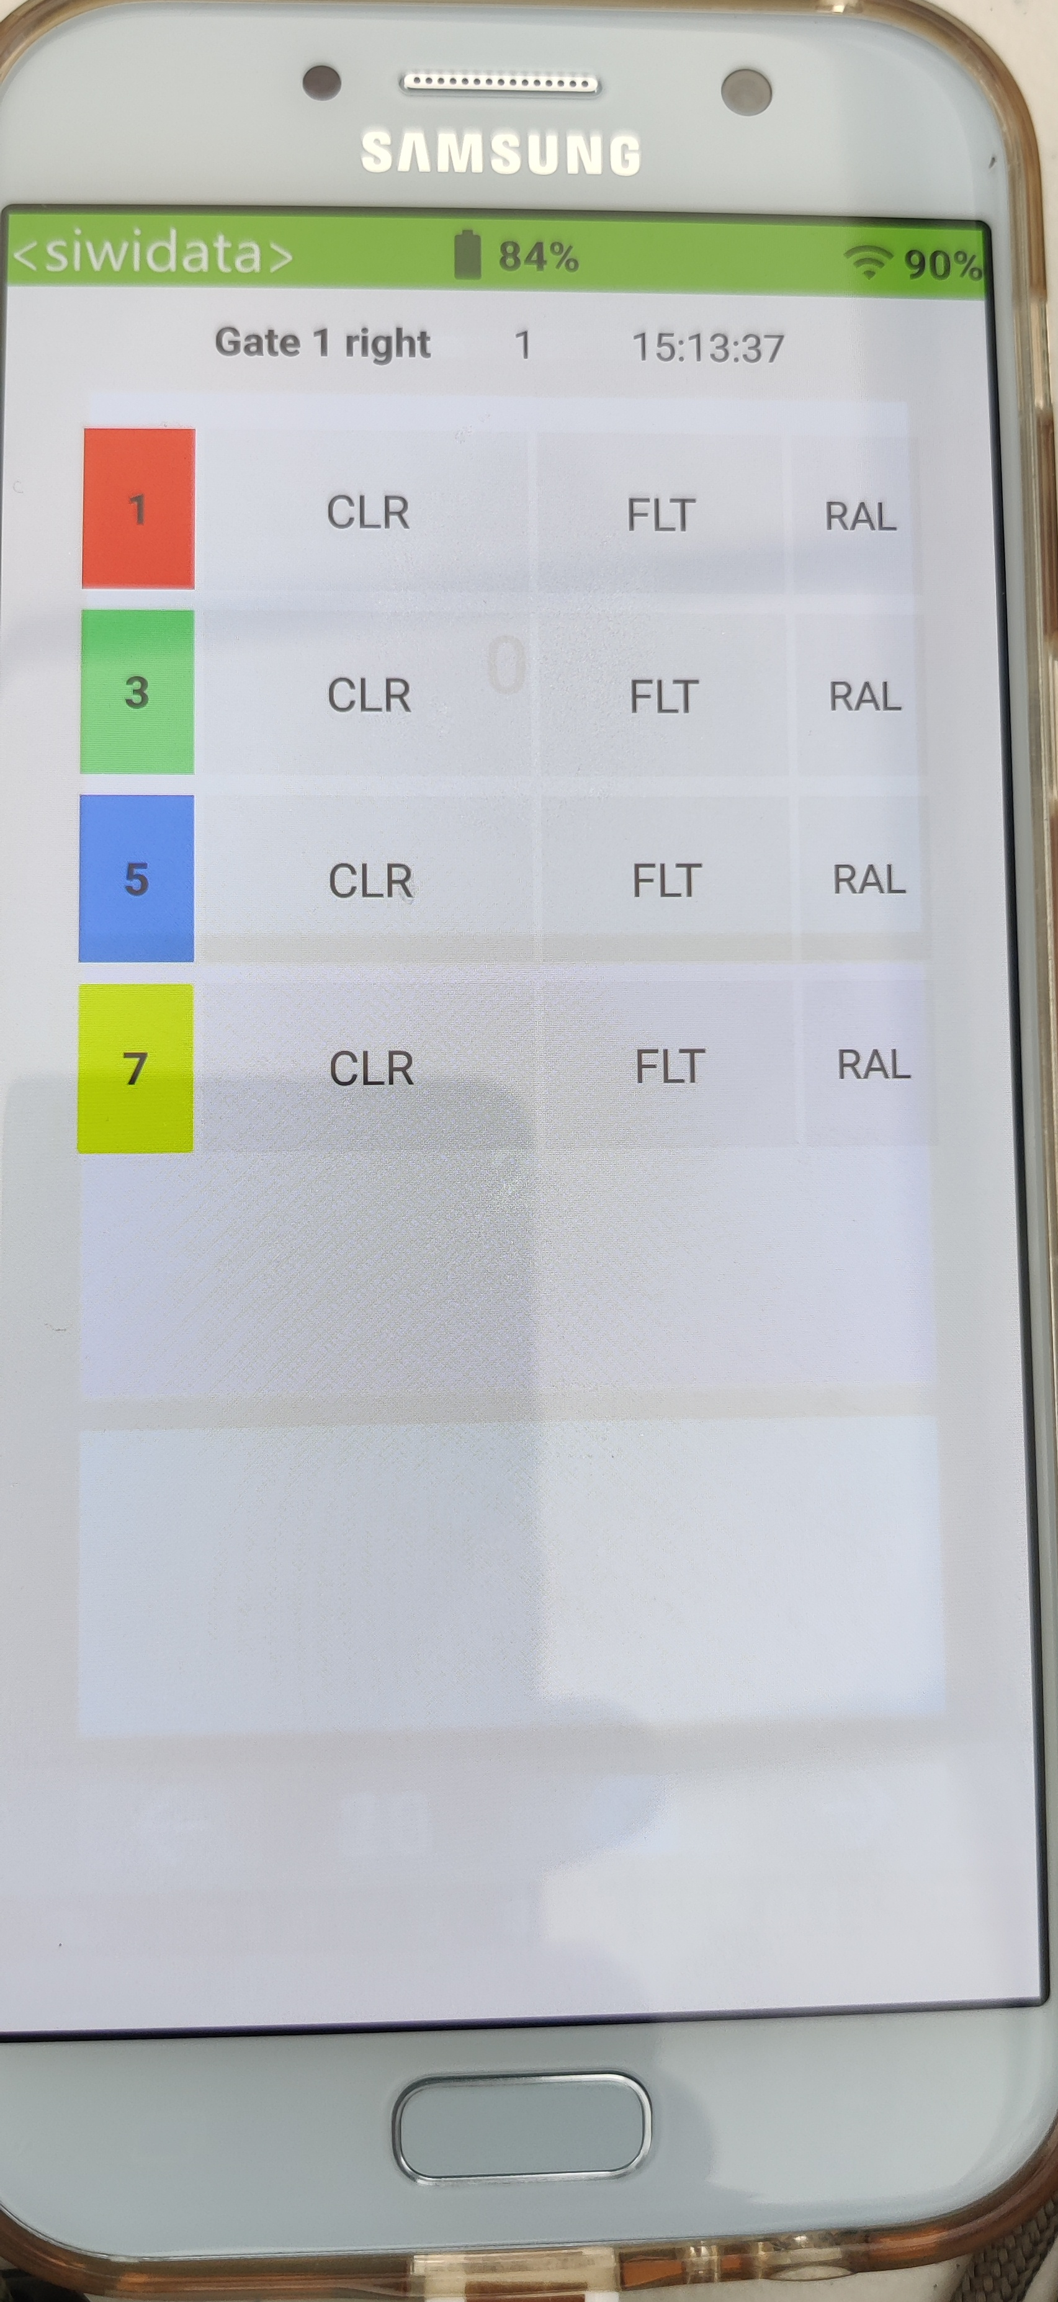
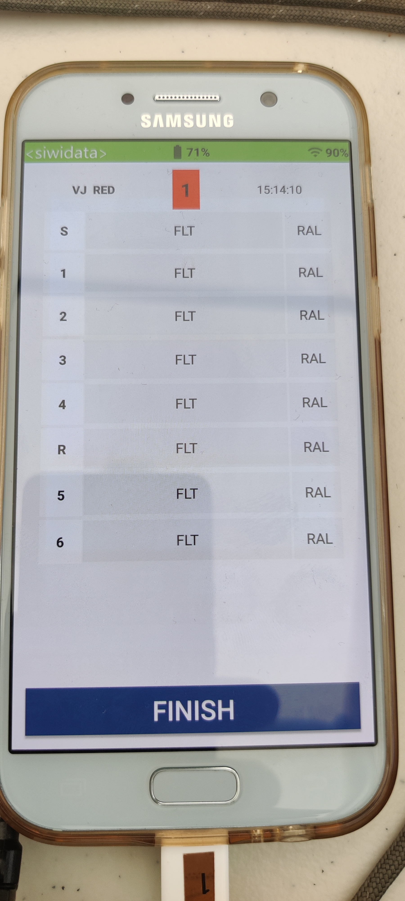
SPI
Gate Judge - TT
Gate Judge – Elim.
Video Judge

Slide 24
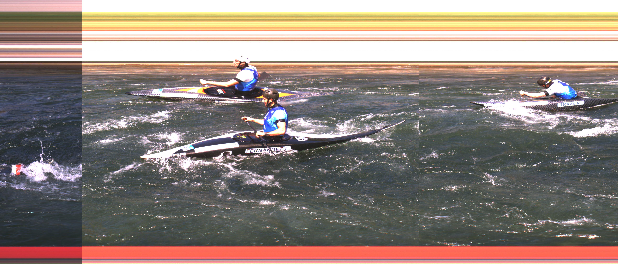
Photo Finish
Criteria to order the photo finish
First the bow of the boats
If impossible to define the exact bow line of each boat, then the first part of the body outside of the kayak

Slide 25
Results – Qualification
Ranking order:
In time order
Ties sorted by ICF CSLX ranking
Then a draw
Number of Athletes who proceed from Time Trial ranked above those who qualify from repechage
Notes:
The gate line is the line from the outside of the gate to the bank on the same side.
The following conditions must be satisfied for a gate to be considered correctly negotiated:
The whole head and both shoulders of the athlete must cross the gate line in accordance with the correct side of the gate and the course plan.
Part of the boat must cross the gate line at the same instant as the whole head crosses the line.
All gates must be negotiated in accordance with the direction established by the course map.
Athletes are permitted to touch the gates with their body or any part of their equipment.

Slide 26
Results - Elimination
Ranking order:
Those with no faults in order of finish
Those with faults
By number of faults
Where first faulted - those who proceed further on the course are ranked higher
Ties broken by time trial rank
RAL’s ranked last
Notes:
The gate line is the line from the outside of the gate to the bank on the same side.
The following conditions must be satisfied for a gate to be considered correctly negotiated:
The whole head and both shoulders of the athlete must cross the gate line in accordance with the correct side of the gate and the course plan.
Part of the boat must cross the gate line at the same instant as the whole head crosses the line.
All gates must be negotiated in accordance with the direction established by the course map.
Athletes are permitted to touch the gates with their body or any part of their equipment.

Slide 27
Video Samples

Slide 28
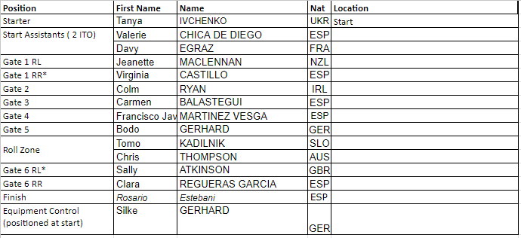
Positions

